Slide 1
Internships and Research Experiences
Why do them
Where to find them

Slide 2
Internships vs Research Experiences
Both give you experience in the field
Both allow you to create connections
Both fill the experiential learning requirement
Internships (done off campus)
Any 499 class
Any discipline
Does not count in Biology major
Research Experiences
Any URES 197
Any 491
May be done off campus

Slide 3
Why do Them?
Personal:
Boost your maturity and self-confidence
Enjoy a greater clarity about career decisions
Improve your human relations skills
Prepare for life after graduation
Academic:
Integrate classroom theory with real-life experiences
Understand the relevance of your course work
Increase your motivation to learn
Use resources that are not available on campus
Professional:
Explore a potential career field
Develop career-related skills and abilities
Observe professional people and behavior
Build a network of professional contacts, potentially developing mentoring relationships
Gain a competitive edge for employment or graduate school admission
Financial:
Approximately 50% of all interns receive some form of compensation
Subsidize tuition costs or use for transportation expenses
Notes:
Allows you to see what real world applications for your discipline are
Give you a chance to have hands on experiences helpful too to determine what you like and don’t like
Useful for future plans (job seeking, post-graduate work)

Slide 4
Internships XXXX499
May be taken for academic credit (and graded)
Credits are variable
1 credit hour = 42 hours of internship activity
2 credit hours = 84 hours
More than 6 credit hours needs special permission
Steps to enrolling for XXXX499
Identify an agency
Find a faculty mentor
Fill out and submit the Internship Contract

Slide 5
The Internship Contract
Available through Office of Academic and Career Services
Fill out completely
Get appropriate signatures
Turn in to Office
Activities at end depend on your Faculty Sponsor
Supervisor will assess your activities
Faculty sponsor will assign grade

Slide 6
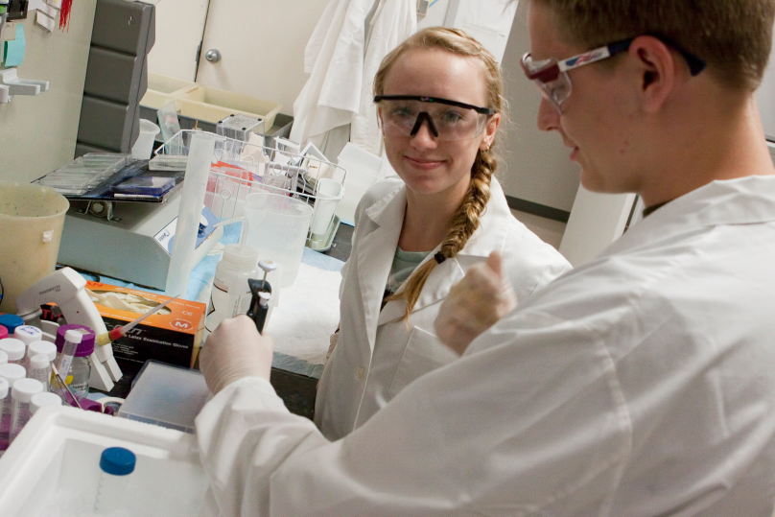
About Internships
When to do them?
during Academic year
between semesters
in the summer
Kinds of Internships?
Research
Medical
Zoological/Botanical
Ecological
Museums

Slide 7
Where and how to Find internships
Office of Academic and Career Services
Links to sites posting internships
Employ-an Eagle
Other WEBsites (do a WEB browser search)
AAAS
Science.gov
FBI
NSF
Department of Energy
Brown University Data Base

Slide 8
Employ-An-Eagle provides
Online job and internship listings
Our resume referral site
Sign up for on-campus interviews or CS events/workshops
Web space to store transcripts, cover letters or writing samples
Information on career fields and specific positions

Slide 9
Start Early
Large employers focus their recruiting efforts in the fall
Federal Agencies often have fall deadlines (or earlier) due to the lengthy hiring process
Deadlines are past for Spring-looking for summer interns now
Take advantage of all opportunities
Think outside the box
For example, there are internships at scientific journals if you are interested in science and in writing
Make sure that you identify your skills, strengths and interests

Slide 10
Getting Stated
Determine a target through self assessment, research and networking
Gather Needed Information (required coursework/ experience, required education, application method/deadlines, etc.)
Prepare
Resume/cover letter
Networking- Eagle Connections
Search for opportunities/make connections
Interviewing Practice
Apply

Slide 11
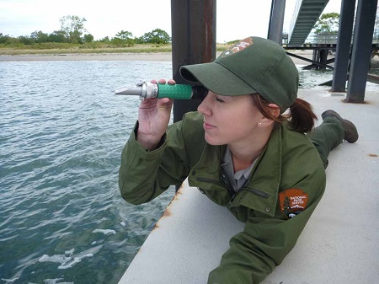
Research Experiences
Actively participate in on-going scientific research
Hands on collecting and analyzing data
May be used as an internship
May be used as other academic credit including major credit
May be on campus or off campus

Slide 12
On-Campus Research Experiences
Requires a Faculty Mentor
Search faculty research interests to identify an area of interest
Look at faculty profiles on UMW WEB page
Biology
Earth and Environmental Science
Chemistry
Physics
Do a Browser search to look for publications
Join ResearchGate to look for publications

Slide 13
On Campus Experiences
Coursework
URES 197
Sign up through the CAS Deans office
491 (Independent Study)
Sign up by special add form (green sheet)
Summer Science Program
Work with a faculty over the 2 summer sessions
Receive a stipend, room and board and expenses for supplies
2 students/faculty

Slide 14
Difference between URES and 491
URES can be done in any discipline (not counted in major)
Students are generally working with a faculty member or other students on a project that is already developed
Can only sign up for 2 URES total
Final report is required
491 done in major discipline (credits toward major)
Students typically develop or help develop project with faculty mentor
Students are given greater responsibility for project
Honors in discipline may be given

Slide 15
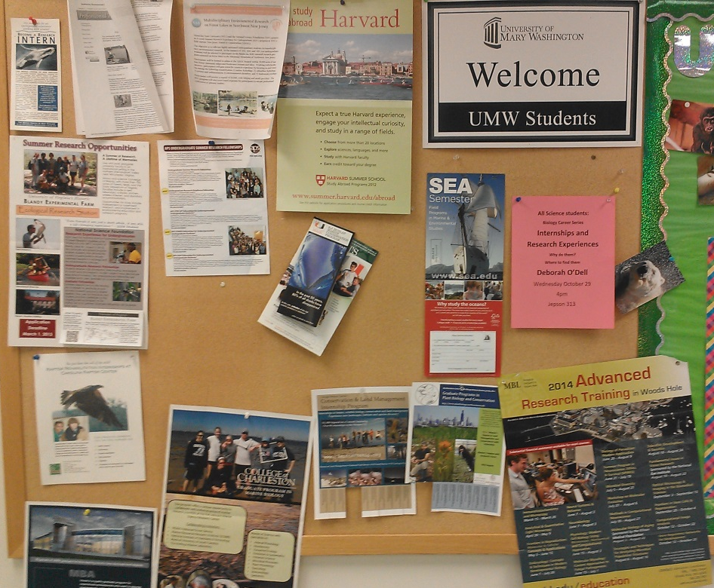
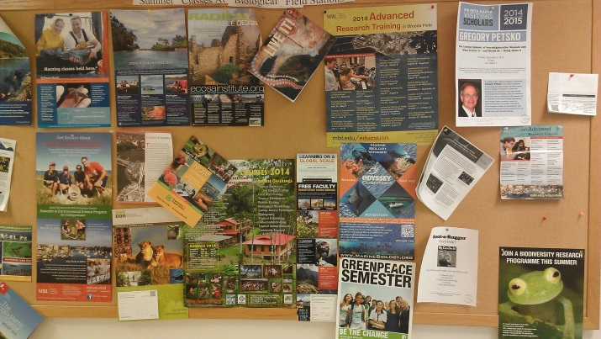
External Research Experiences
Find them same place as internships
Search WEB
Look at Field Stations
Look at advertisements on Bulletin Boards in hallways
Take summer classes at field stations
Not all classes are Field classes
Can get financial assistance

Slide 16
Other advantages of doing a Research Project
Students gain experience giving professional presentations
Students may present at Student Research and Creativity Day
Local/National Scientific Conferences
Conference Paper: Dam removal, hydrogeology, and biological systems: Data from a freshwater, tidal system Alan B. Griffith, Ben Kisila, Abbie Tomba, Werner Wieland, Shelby Zelonis, Emily Alberto
Students may be co-authors on Scientific Publications
Do song-phrase production rate and song versatility honestly communicate male parental quality in the Gray Catbird? Andrew S. Dolby¹, Charles E. Clarkson, Eric T. Haas, Jennifer K. Miller, Layne E. Havens, and Brandon K. Cox Department of Biological Sciences, University of Mary Washington, 1301 College Avenue, Fredericksburg, Virginia 22401 USA
Notes:
Good time to find projects/faculty

Slide 17
Other places to find Experiences
Use Professional Organizations. They often have jobs/internships and research opportunities posted.
Physics
Biology
Chemistry
Earth and Environmental Science

